Slide 1

Visualizing Sustainability: A Cognos-Based Analysis Of Global Trends (2000-2023)
M.INDUMATHY
indumatm@srmist.edu.in

Slide 2

Agenda
Problem understanding
DATA Collection
DATA PREPARATION
DATA VISUALIZATION
DASHBOARD
STORY
REPORT
PERFORMANCE TESTING
WEB INTEGRATION

Slide 3

Introduction
The Sustainable Development Report (SDR) reviews progress made each year on the Sustainable Development Goals since their adoption by the 193 UN Member States in 2015
The Sustainable Development Goals or Global Goals are a collection of seventeen interlinked objectives designed to serve as a "shared blueprint for peace and prosperity for people and the planet, now and into the future."

Slide 4
PROBLEM UNDERSTANDING
Develop a user-friendly dashboard that leverages the Sustainable Development Report 2023 dataset to provide a comprehensive and insightful analysis of countries' progress towards achieving Sustainable Development Goals (SDGs).Display a ranking of countries based on their overall sustainability scores. Allow users to filter the rankings by region, income group, or specific SDGs.

Slide 5
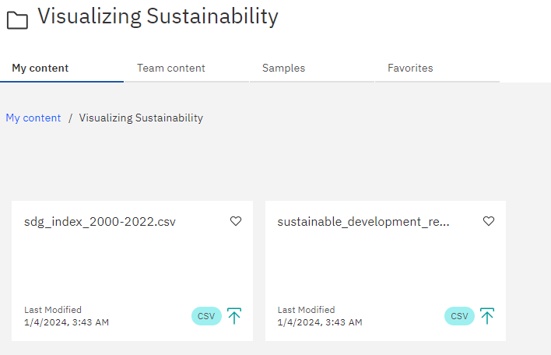
DATA COLLECTION
DATA is collected from Kaggle and its connected to the IBM COGNOS

Slide 6
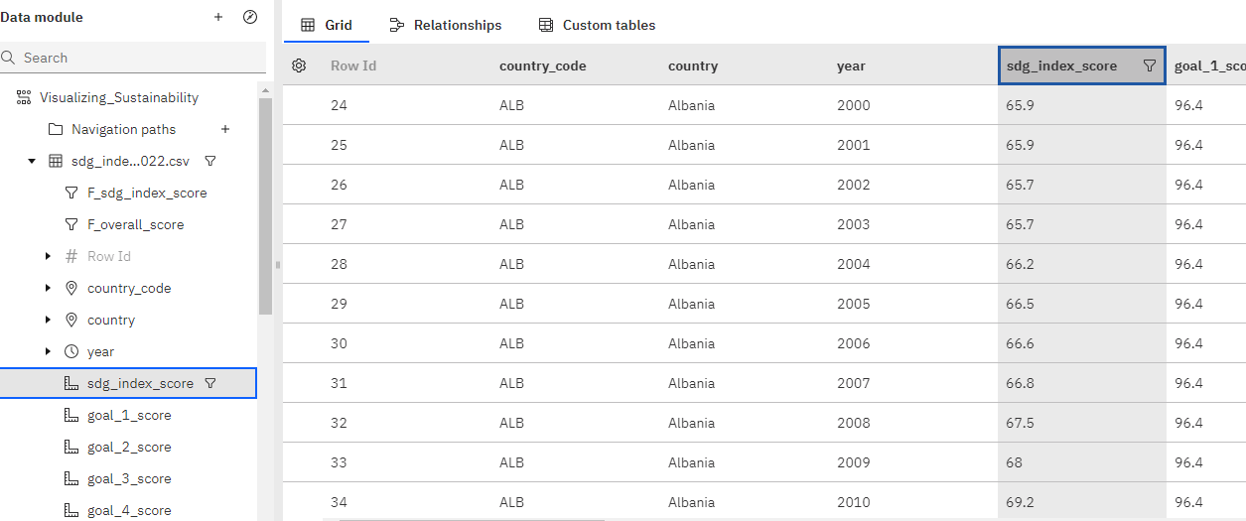
DATA PREPARATION
DATA MODULE CREATION DONE for the datasets provided and data is represented as grid

Slide 7
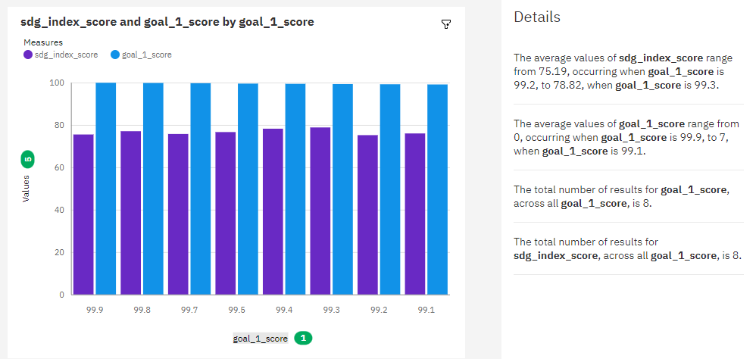
Analysis On Overall Sustainability On No Poverty

Slide 8
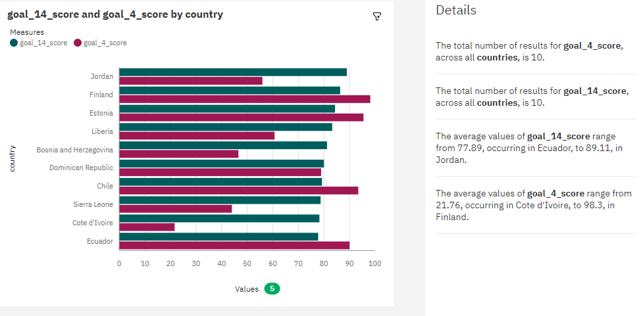
Analysis Overall Sustainability On Quality Education

Slide 9
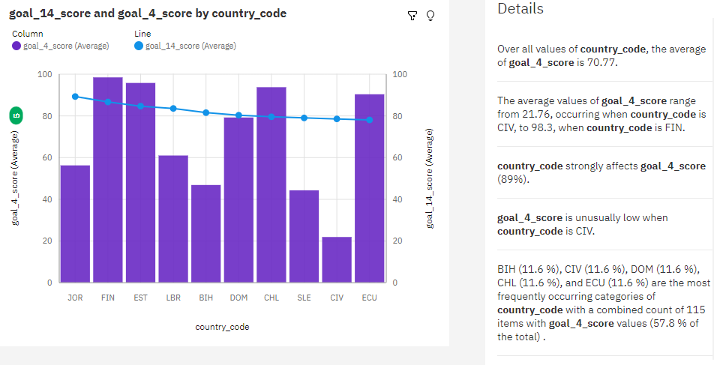
Analysis On Overall Sustainability Life Below Water

Slide 10
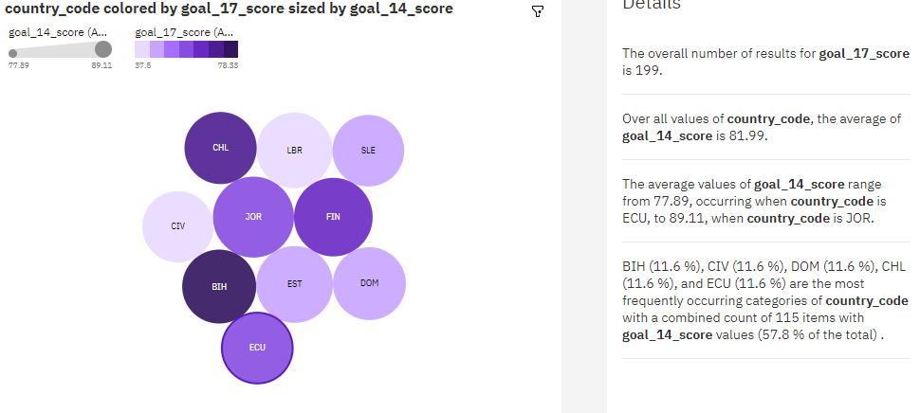
Analysis On Overall Sustainability Partnerships For The Goals

Slide 11
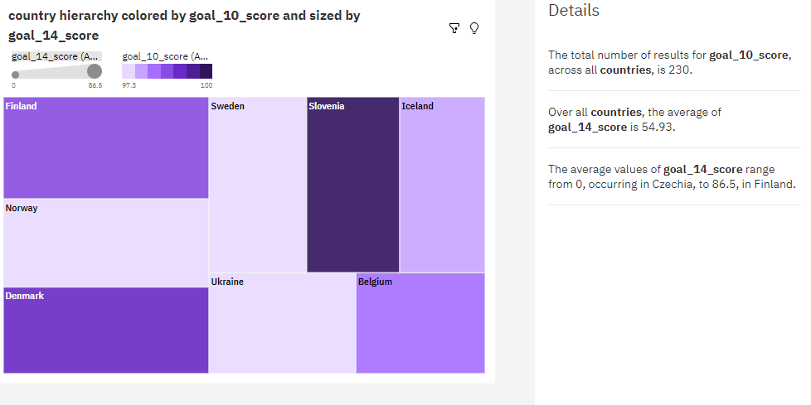
Analysis On Overall Sustainability Reduced Inequalities

Slide 12
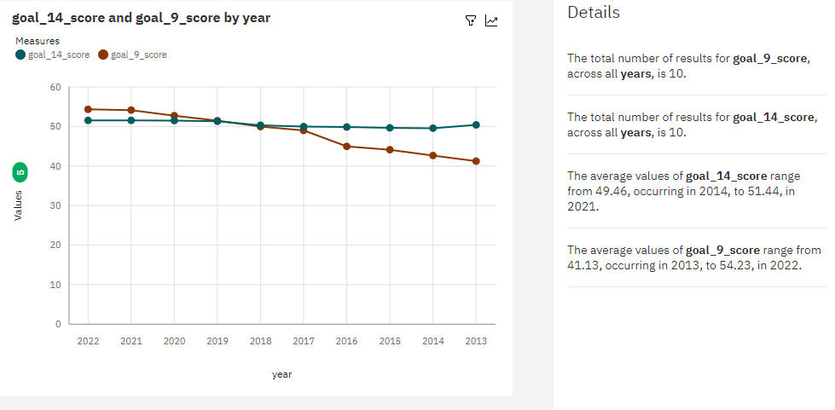
Analysis On Overall Sustainability Industry, Innovation And Infrastructure

Slide 13
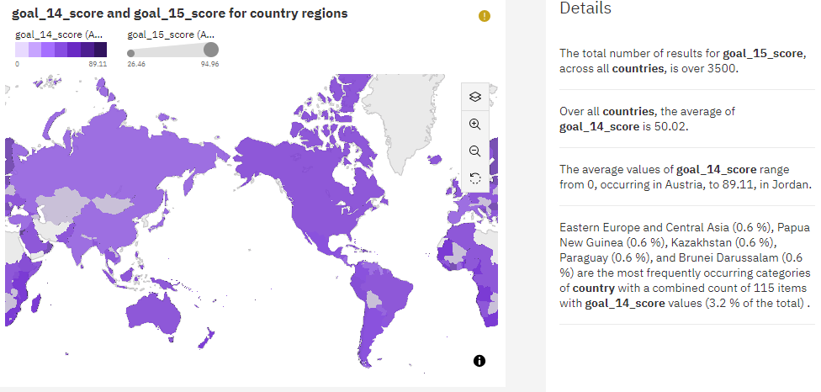
Analysis On Overall Sustainability Life On Land

Slide 14
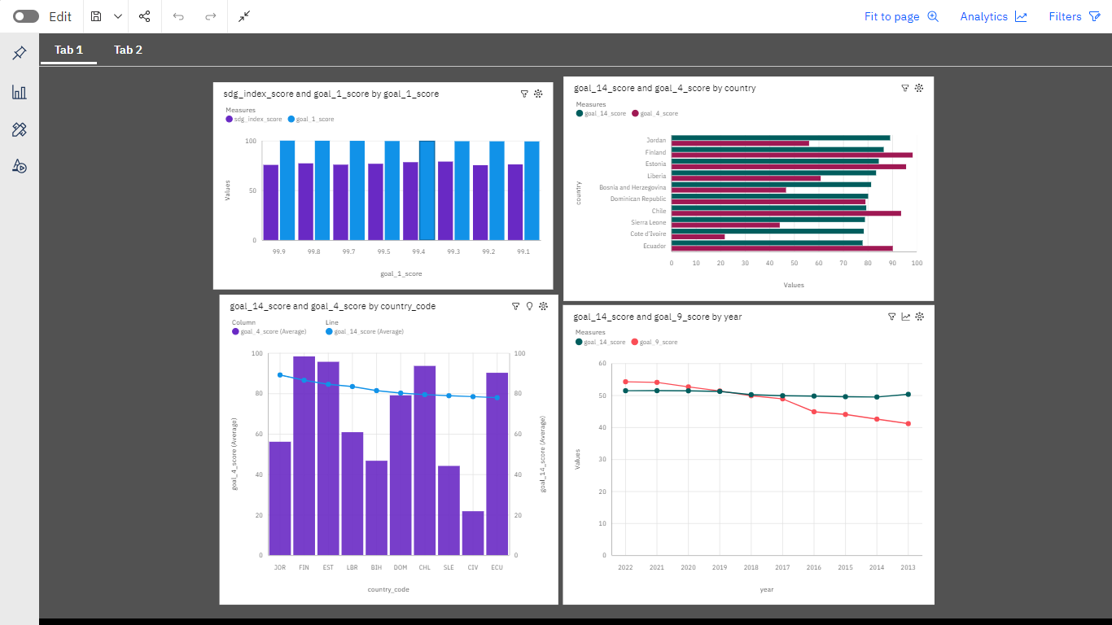
VISUALIZING SUSTAINABILITY DASHBOARD

Slide 15
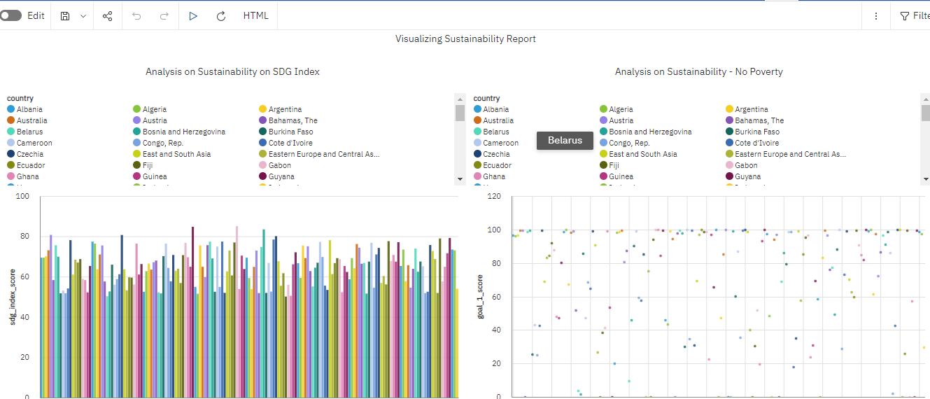
VISUALIZING SUSTAINABILITY REport

Slide 16
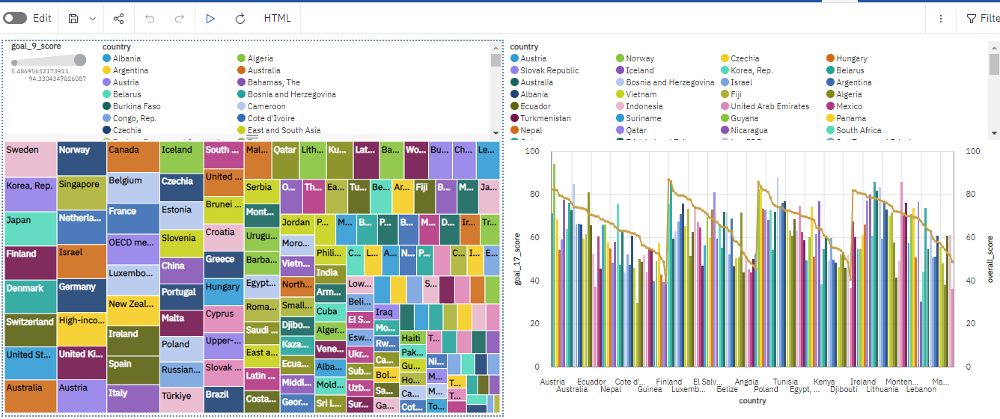
VISUALIZING SUSTAINABILITY REport

Slide 17
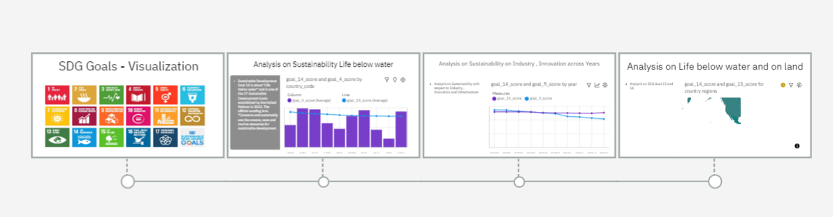
VISUALIZING SUSTAINABILITY story

Slide 18
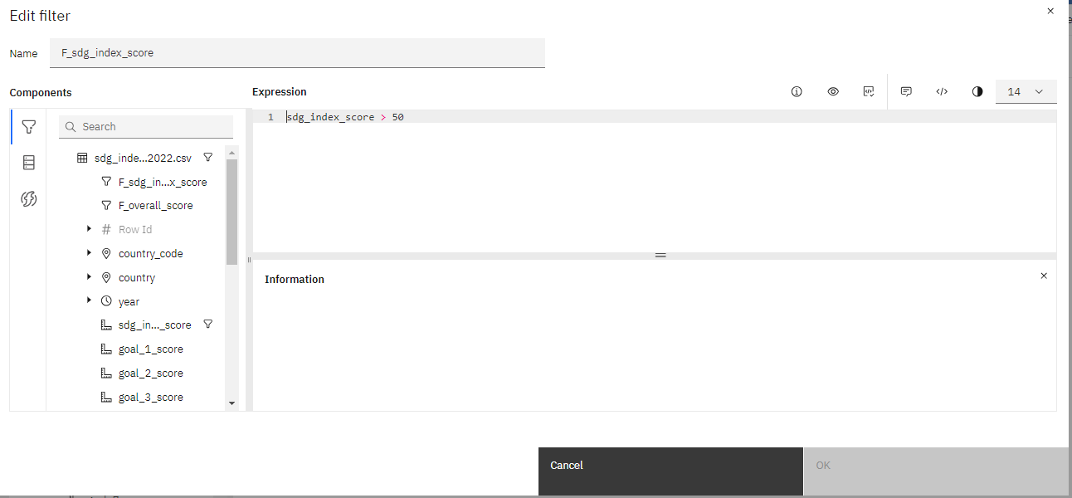
Performance testing – data filters

Slide 19
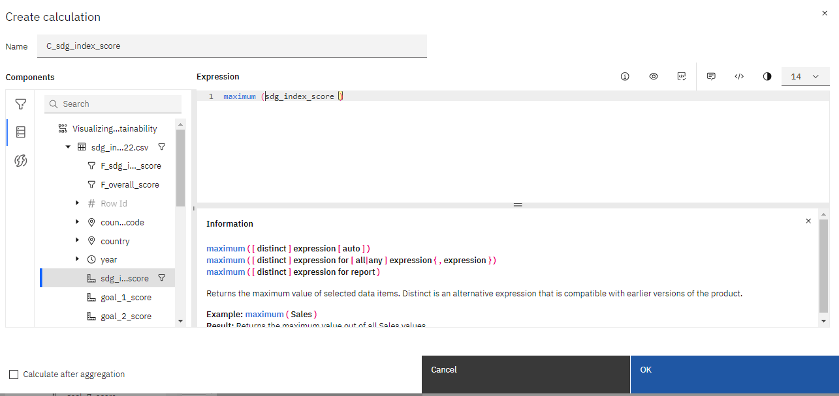
Performance testing – data filters

Slide 20
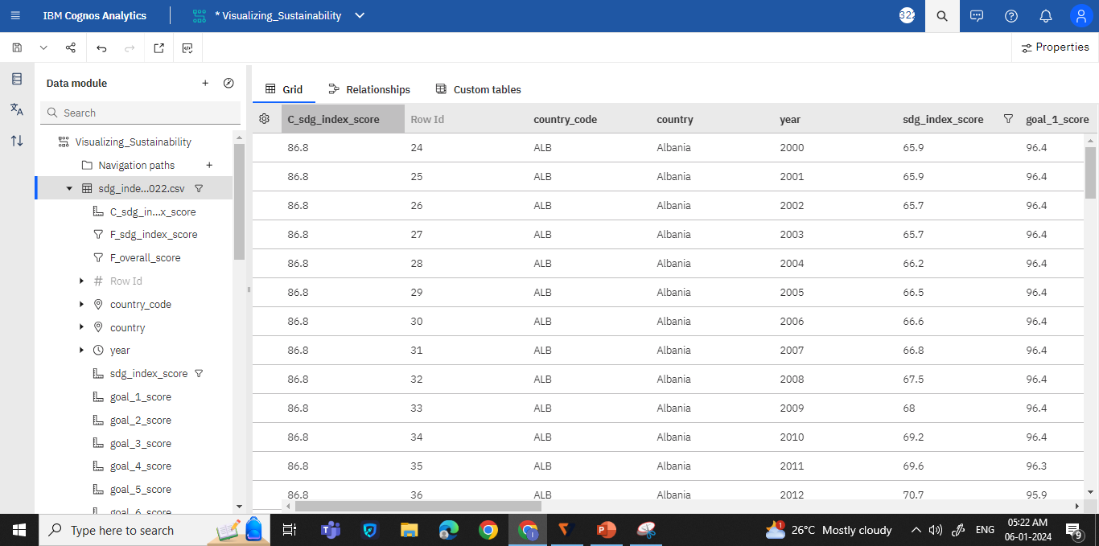
Performance testing – data filters
Max Score

Slide 21
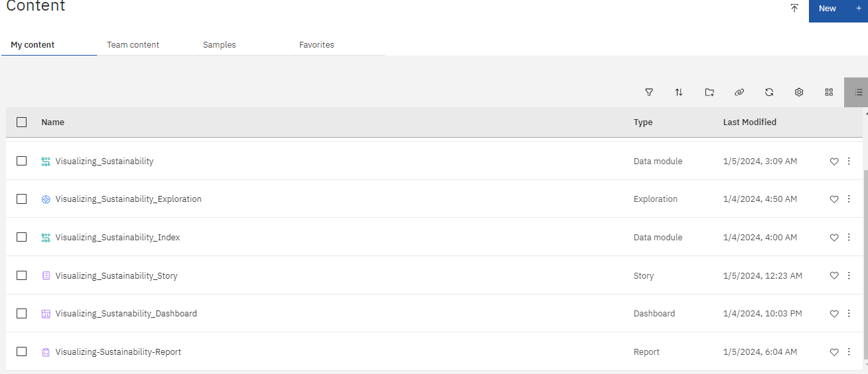
MY CONTENT - SNAPSHOT

Slide 22
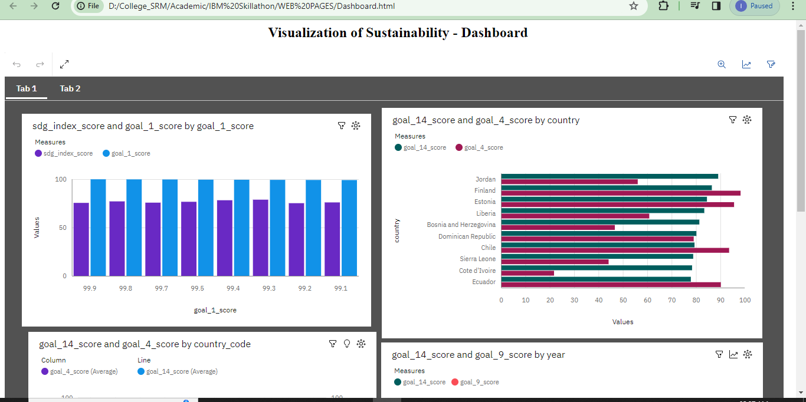
Web integration

Slide 23


Thank you
Ms M.INDUMATHY​
Srm institute of science and technology
vadapalani
indumatm@srmist.edu.in

